Slide 1
Source Code Authorship Attribution and Verification under
Adversarial Conditions
Team 16: Elang Sisson and Andrew Varkey

Slide 2
Introduction
Introduction: The purpose of the project is to investigate the robustness of source code authorship attribution systems against adversarial attacks through misattribution and evasion techniques.
Team Roles:
Prompt generation and data collection:
Elang Sisson
Andrew Varkey
Sprint 5 Goals:
Produce more results
Analyze and share results
Document findings and record procedure presentability and reproducibility

Slide 3
Sprint 5 Objectives
Evolutionary Prompt Framework
Build an iterative system that tracks positive and negative results, builds on successful transformations, and prunes ineffective directions to converge on optimal evasion strategies
Expanded Test Dataset
Scale adversarial experiments with broader coverage of transformation categories and authors, leveraging the batch automation infrastructure built last sprint.
Documentation and Reproducibility
Begin planning the documentation of experimental methodology and key findings so the research is understandable and replicable by future teams working on the project
Cross Model & Feature analysis
Compare which stylometric features are most effective for evasion and identify which classifiers are the most vulnerable to specific transformation categories

Slide 4
Feature Implementation
Evolutionary Prompt Refinement Framework
Before: Testing prompts in isolation with no feedback loop between results
After: Iterative framework that builds on successful transformations while pruning failures, converging on optimal evasion strategies.
Per Model Vulnerability Profiling
Before: Aggregate evasion rates without model specific or feature level breakdown
After: Comparative analysis that identifies which classifiers are most/least robust and which stylometric features drive evasion success.
Expanded Adversarial Test Dataset
Before: Limited set of adversarial test cases focused on proving automation worked
After: Broader coverage across transformation categories (restructuring, renaming, etc.) and multiple authors for more robust results.

Slide 5
Feature Demo

Slide 6
Deployment and Testing
Research Project Context:
As a research project, deployment means running our adversarial framework against the client provided attribution models and producing structured, reproducible results. There is no traditional deployment since our project is a python based experimental pipeline.
Testing Methodology:
Batch runs across 4 classifiers
Multiple AI providers tested such as Claude, Gemini and ChatGPT
Evolutionary iteration with tracked metrics
Results validated via CSV/JSON export
Client Feedback:
Wants documentation easily understandable for anyone not involved in the project and for future students working on project

Slide 7
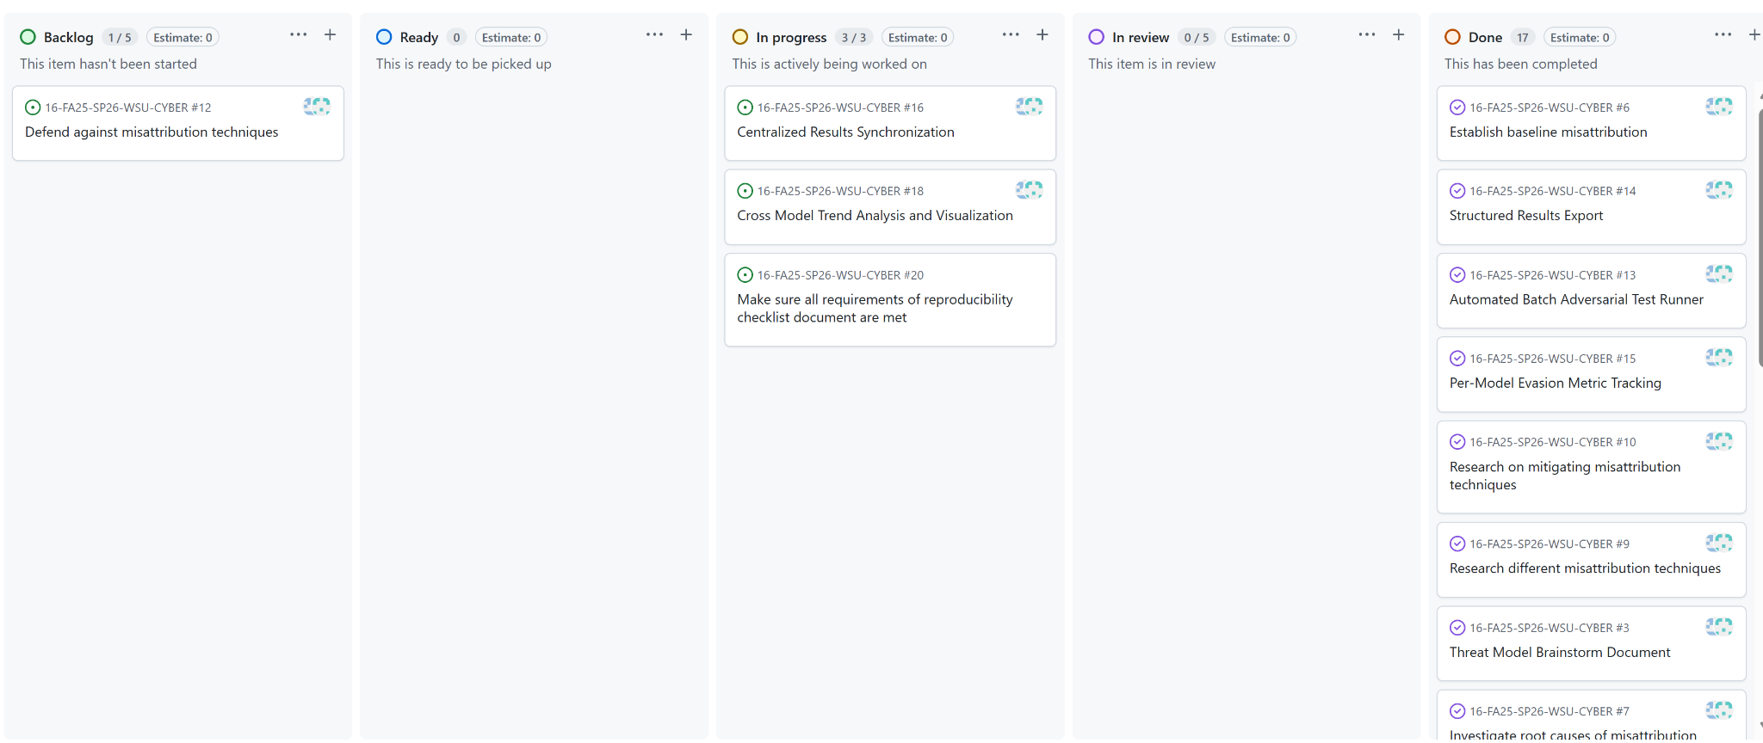
KanBan

Slide 8
Team Contributions
Completed
Expanded Adversarial Test Dataset
Evolutionary Prompt Refinement Framework
Cross Model and Feature Comparative Analysis
In Progress
Cross Model Trend Analysis
Centralized Results Sync
Defense Against Misattribution
Framework Documentation and Replication Guide
Individual Contributions
Elang sisson and Andrew Varkey:
Evolutionary prompt framework design
Cross model analysis and result comparison
Expanded test dataset
Feature level Evasion Analysis

Slide 9
Client Meetings
Meeting 7:
Agenda:
Review produced results
Discuss testing framework and methodology
Discuss on creating a document for understandability and future replication
Decisions Made:
Create a new document that discusses our methods and decisions

Slide 10
Documentation of Report
Sprint 5 Report Updates
Added evolutionary prompt refinement framework to What’s New section
Updated Work Summary reflecting shift from infrastructure to analytical depth
Document incomplete issues with explanations
Further details on sprint 5 report

Slide 11
Responsible Use of AI
Used to generate adversarial code transformation
Summarize unfamiliar concepts
Organizing documentation and repository structure
Suggestions for transformation ideas by category
AI outputs are verified for accuracy
AI used as a tool since it’s the core of the project

Slide 12
Sprint Achievements and Challenges
Achievements
Evolutionary framework systematically discovers effective transformations
Expanded datasets provides more robust and generalizable results
Clear patterns identified in classifier vulnerabilities
Challenges and Solutions
Defining reproducible methodology for the evolutionary framework
Balancing depth of analysis vs breadth of attack types
CSV tracking continues and looking into a database to sync data

Slide 13
Next Steps and Retrospective
Sprint 6 Planned Tasks
Adversarial Framework Documentation and Replication Guide
Build visualizations of evasion trends and feature importance
Implement database backed persistence for result storage
Cross model trend analysis and statistical visualization
Retrospective
What went well:
Evolutionary framework, cross model insights, expanded dataset
To improve:
Dedicate time for documentation, implement persistent storage soon

Slide 14
Conclusion
Sprint 5 Accomplishments
Designed evolutionary prompt refinement framework for systematic discovery of optimal adversarial transformations
Expanded adversarial dataset for broader, more robust results
Identified clear patterns in classifier vulnerabilities to specific attack types

